Slide 1



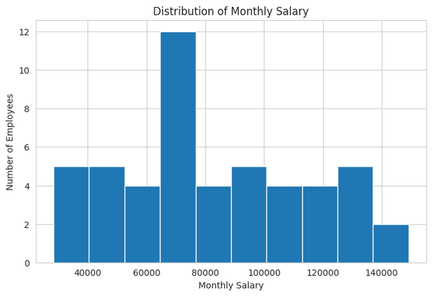
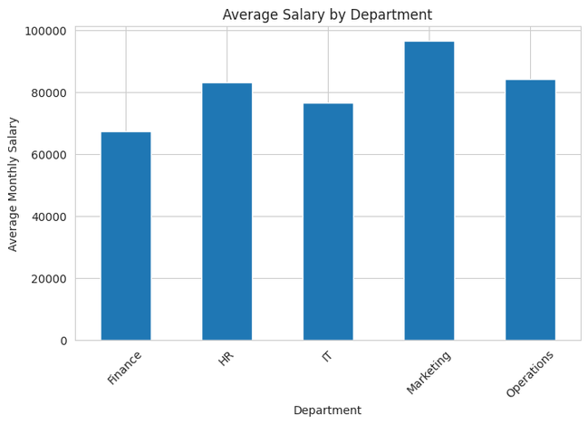
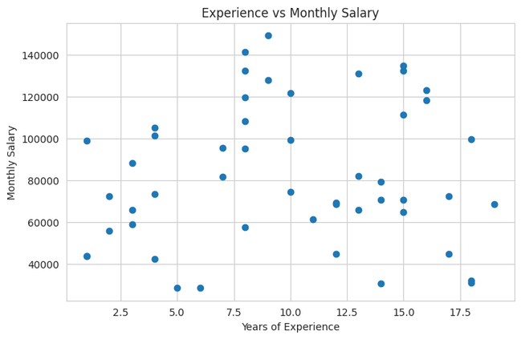
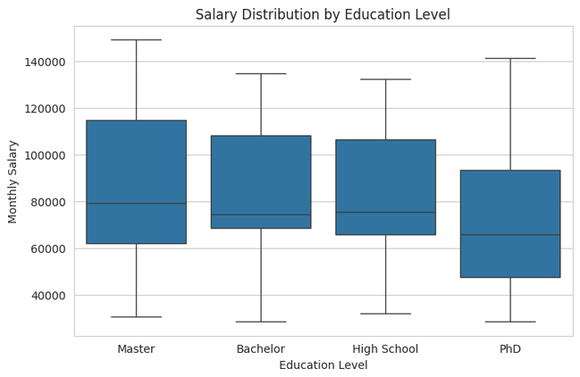
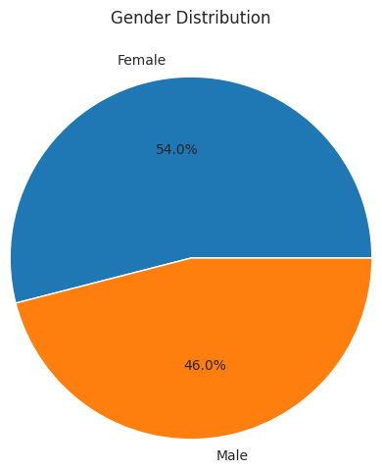
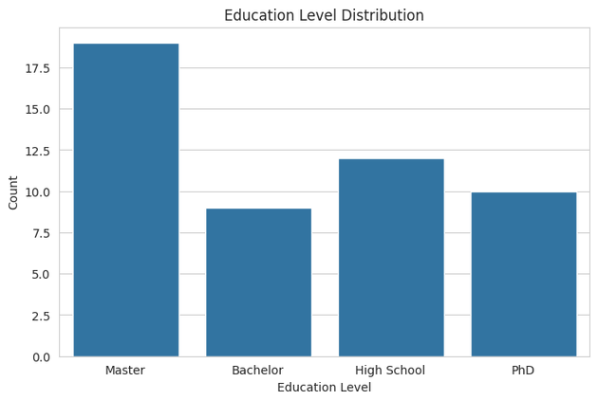
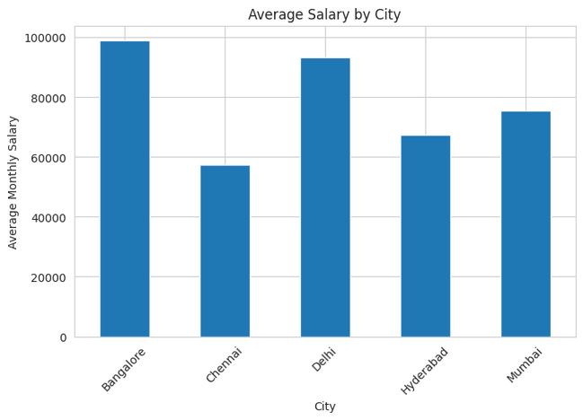
STATISTICAL ANALYSIS OF EMPLOYEE SALARY DATA USING MEAN AND VARIANCE
DSA0405- FUNDAMENTALS OF DATA SCIENCE
Jeya Harshini R 192424051 B.tech AI&DS
SUBMITTED TO: DR KRISHNARAJ M
Abstract
Dataset Description
Results & Visualizations
📘
📁
📈
Dataset: Employee Salary Dataset
Records: 50 employees, 9 attributes
Departments: IT, HR, Finance, Marketing, Operations
Education levels: High School, Bachelor's, Master's, PhD
₹82,289
₹73,891
1.12B
₹33,521
₹28,420
₹149,123
Employee salary analysis plays an important role in understanding workforce compensation patterns and organizational decision-making. This study analyzes employee salary data using descriptive statistical measures such as mean, variance, median, and standard deviation. The dataset consists of employee demographic and professional attributes including department, education level, age, gender, city, experience, and monthly salary. Various visualizations were created to identify salary trends, departmental differences, and factors influencing employee compensation.
Mean
Median
Variance
Std. Dev.
Minimum
Maximum
Name | Dept. | Exp. | Education | Salary
Employee_1 | Marketing | 15 | Master | ₹111,416
Employee_2 | Operations | 7 | Bachelor | ₹95,271
Employee_3 | IT | 12 | High School | ₹69,064
Employee_4 | Operations | 8 | PhD | ₹95,091
Employee_5 | Operations | 15 | Master | ₹132,450
Salary Distribution
Avg. Salary by Department
Experience vs. Salary
Salary by Education
Introduction
💡
Methodology
Salary analysis is a fundamental application of data science in human resource management. Organizations use statistical methods to evaluate compensation, identify disparities, and support strategic workforce planning. This project applies core statistical concepts to understand:
🔬
Step 1 — Data Collection
Employee salary data collected from a structured dataset of demographic and professional information.
Step 2 — Data Cleaning
Checked for missing values • verified salary records • ensured data consistency
Step 3 — Statistical Analysis
Average salary levels
Salary variation among employees
Impact of experience on salary
Department-wise salary differences
Educational influence on compensation
Mean = (Σ X) / N
Most employees fall within the medium salary range.
Marketing and HR show the strongest departmental averages.
Salary tends to increase with years of experience.
Higher qualifications generally earn higher salaries.
Mean
Average salary
Variance = Σ(X − mean)² / N
Objectives
Variance
Salary dispersion
SD = √Variance
🎯
Std. Deviation
1
Calculate the mean monthly salary of employees
Avg. deviation from mean
Data Science Workflow
Gender Distribution
Avg. Salary by City
Education Level Counts
Why It Matters
2
🔄
💡
Determine salary variance and standard deviation
🗃
Data
Collection
🧹
Data
Cleaning
3
Analyze salary distribution patterns
Seven complementary views — spread, comparison, correlation, and composition — turn 50 raw salary records into clear, decision-ready insight for HR and business teams.
4
Compare salaries across departments and education levels
🔍
Exploratory
Data Analysis
❓
Missing Value
Checking
5
Identify relationships between experience and salary
🔢
Statistical
Analysis
📊
Data
Visualization
Balanced representation: 54% female, 46% male.
Bangalore and Delhi post the highest city averages.
Master's degree holders form the largest group.
✅
✅
Key Findings
Applications
🏢
Conclusion
Future Scope
Salaries show moderate variation across departments
HR: compensation planning & benchmarking
🏁
🚀
Experience correlates positively with salary
This study successfully applied fundamental statistical techniques to employee salary data. Mean and variance provided insights into salary distribution, while visualizations revealed relationships between salary, experience, education, and department — demonstrating how basic data science methods support HR decision-making and organizational planning.
Salary prediction using Machine Learning
Higher education aligns with higher compensation
HR: workforce budgeting
Performance-based compensation analysis
A few high earners lift the overall average
Analytics: salary trend identification
Salary forecasting with regression models
Analytics: resource allocation & optimization
🏢
🏁
🚀
Department & education jointly drive salary gaps
Interactive HR dashboard development
Data Science: reporting & decision support
Attrition & retention analysis
Notes:
1

